Slide 1
Network Infrastructure Design and Implementation
Work of:
Budai József
Csépányi Bárdos Letícia
Berki Dorina

Slide 2
Introduction
Our task was to design, test and implement a network infrastucture for a medium-sized company's three locations. The goal was to build a stable, secure, and scalable network that ensures the smooth operation of business processes and allows employees to work efficiently, whether on-site or through remote access.

Slide 3
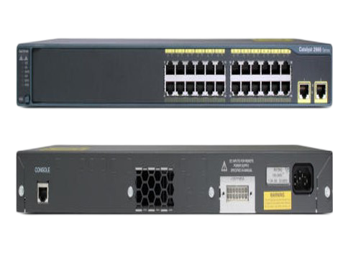
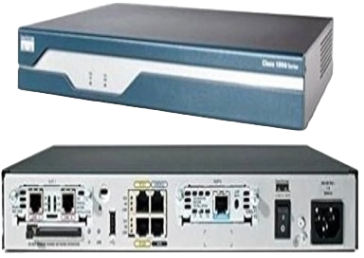
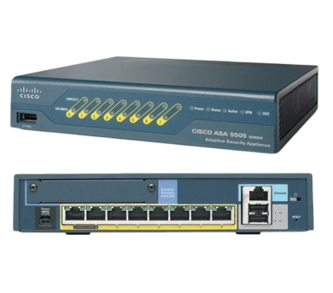
Devices Used
1841 Router
2960-24TT Switch
Cisco ASA 5505
Cisco ASA 5505

Slide 4
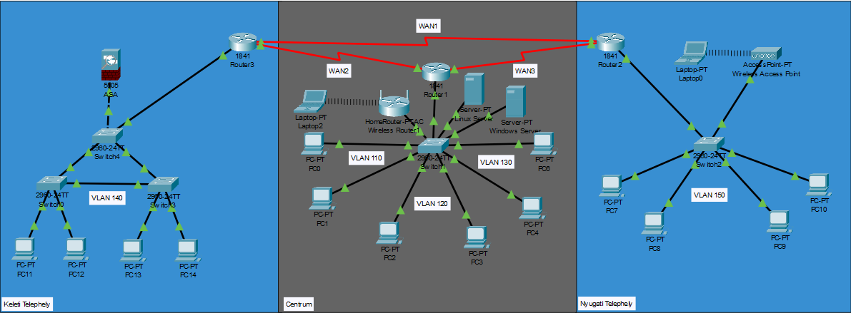
Physical Topology
East Centrum
West

Slide 5
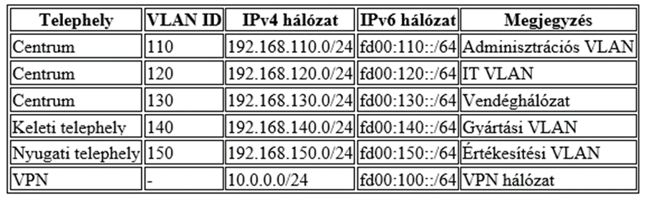
Logical Topology

Slide 6
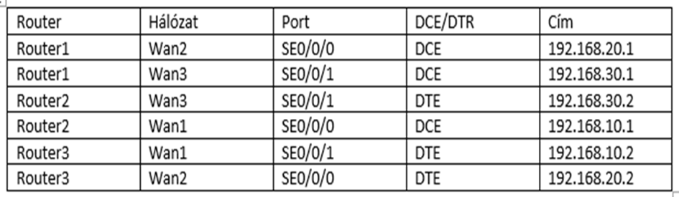
Logical Topology
WAN Address Table

Slide 7
Configuring devices
Technologies we have used to configure the devices:
DHCP (Dynamic Host Configuration Protocol)
VLAN (Virtual Local Area Network)
OSPF (Open Shortest Path First)
WAN (Wide Area Network)
VSRP, HSRP (Virtual Switch Redundancy Protocol, Hot Standby Router Protocol)
VPN (Virtual Private Network)

Slide 8
Group work division
Berki Dorina: Linux server, DHCP, DNS
Csépányi-Bárdos Letícia: Documentation, Hungarian-language presentation
Budai József: Network topology creation and programming, English-language presentation.

Slide 9
THANK YOU FOR YOUR ATTENTION!

